Slide 1

Smart Home Lighting System
Group One(1) Members
NAMES
Wendy Nana Aba Amu Asamoah
Esther Twenebeah Koduah
Gabriel Kwankye Yeboah
Kwaku Mensah-Abrampah
Akabua Elisha Nunana
Yawlui Melvin Kwaku
Osei Poku Brempong
Tettey Ara Dede
Samuel Bizimana
Attah Marcel
Gyamfi Felix

Slide 2

Table of Contents
1
Problem Statement
Defining the need for a smart lighting solution.
2
Methodology
The technical approach and strategy used.
3
System Components
Overview of hardware and software architecture.
4
Code Overview
Key features and quality of the software design.
This presentation provides a comprehensive overview of our smart home lighting system project. We begin by addressing the core issues with conventional lighting, followed by the methodologies employed. An in-depth exploration of system components and code design is then presented. Finally, we conclude with a demonstration and a discussion of challenges and future improvements.

Slide 3
Problem Statement
Home Lighting Challenges
Objective
Inefficient manual light switching
Automates light management
High energy consumption
Reduces energy waste
Lack of adaptive lighting solutions
Provides multiple control modes
Limited room-specific control
Enhances user convenience
Traditional home lighting systems suffer from several inefficiencies. Manual light switching often leads to lights being left on unnecessarily, resulting in high energy consumption. The absence of adaptive solutions means lighting doesn't adjust to ambient conditions, while limited room-specific control restricts customization. Our objective is to develop an intelligent system that automates management, reduces energy waste, provides multiple control modes, and enhances user convenience.

Slide 4

Methodology
1
Microcontroller Selection
Arduino UNO R3 as the central controller, offering a versatile and programmable platform for managing the lighting system.
2
Sensor Integration
Employing PIR motion sensors for accurate occupancy detection and a photoresistor for precise ambient light measurement.
3
Control Mechanisms
Implementing automatic mode for hands-free operation, manual override for personalized control, and a voice command interface for added convenience.
4
Programming Strategy
Utilizing a state machine design for robust system behavior, interrupt-like polling for timely responses, and EEPROM for persistent configuration storage.

Slide 5
System Components
Microcontroller
Sensors
Display
Arduino UNO R3: The central processing unit, managing all sensor inputs and actuator outputs.
3x PIR Motion Sensors: Detect occupancy in different rooms.
16x2 I2C LCD: Provides a user interface for system status and manual control options.
1x Photoresistor: Measures ambient light levels for adaptive control.
The smart home lighting system comprises several key components. At its core is the Arduino UNO R3 microcontroller, responsible for processing sensor data and controlling actuators. Three PIR motion sensors detect occupancy, while a photoresistor measures ambient light. A 16x2 I2C LCD displays system status and enables manual control. These components work together to provide intelligent and automated lighting.

Slide 6
Code Overview
Software Design
Key Code Features
Multi-mode operation implementation
Automatic light control algorithm
Efficient sensor reading techniques
Voice command processing
State management
EEPROM threshold configuration
Error handling
Debounce mechanism
The software design emphasizes multi-mode operation, allowing the system to adapt to different user preferences and environmental conditions. Efficient sensor reading techniques ensure accurate and timely data acquisition. State management is crucial for maintaining system stability, while robust error handling mechanisms prevent unexpected behavior. The automatic light control algorithm, voice command processing, EEPROM threshold configuration, and debounce mechanism are key features.

Slide 7




Demonstration/Simulation
Automatic Mode
Motion-triggered lighting with ambient light consideration ensures energy-efficient operation.
Manual Control
Button-based override provides individual room control, allowing users to customize their lighting preferences.
Voice Command Interface
Serial command processing enables multiple operational modes, enhancing user convenience and accessibility.
The system is designed to showcase energy efficiency, user convenience, and adaptive lighting capabilities. The demonstration highlights the seamless transition between automatic and manual modes, as well as the effectiveness of the voice command interface. We anticipate that these features will significantly improve the user experience and promote energy conservation in home environments.

Slide 8
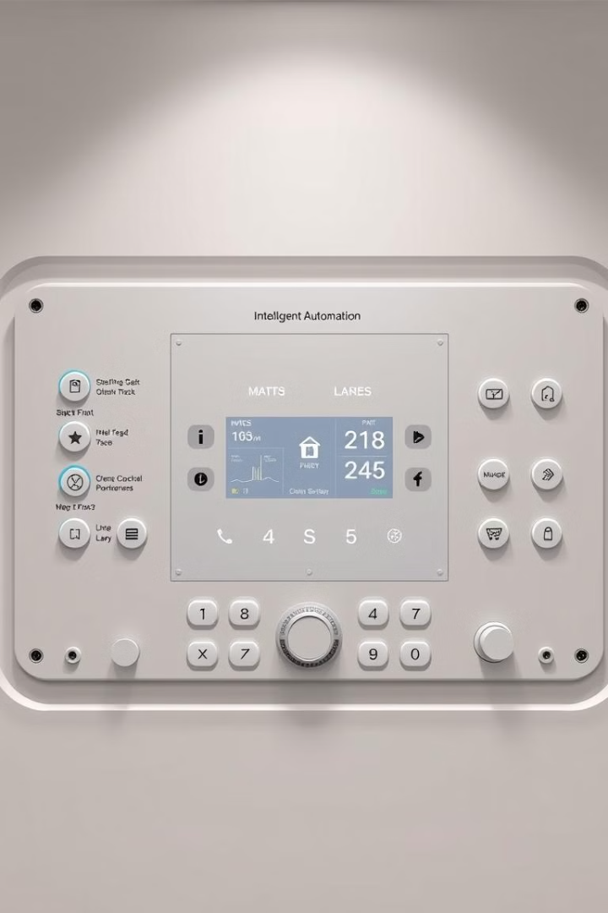


Conclusion
Smart Lighting Implemented
Interdisciplinary Skills
Real-World Challenge Solved
In conclusion, our project successfully implemented a smart lighting system, demonstrating our interdisciplinary skills and providing a solution to a real-world home automation challenge. Key learnings included microcontroller programming, sensor integration, and complex system design. The future of home automation lies in intelligent, adaptive environments and sustainable technology solutions, and this project contributes to that vision.

Slide 9
Challenges and Improvements
Encountered Challenges
Potential Improvements
Sensor calibration
Wireless connectivity
Precise motion detection
Mobile app integration
Power management
Advanced machine learning
Enhanced sensor fusion
Throughout the project, we encountered challenges in sensor calibration, achieving precise motion detection, and optimizing power management. Potential improvements include incorporating wireless connectivity for remote control, integrating a mobile app for enhanced user interaction, implementing advanced machine learning algorithms for predictive lighting, and enhancing sensor fusion for more accurate environmental data.

Slide 10

THANK YOU!
We appreciate your time and attention!

